Slide 1
Splunk Your Hobby
3d Printing Edition

Slide 2
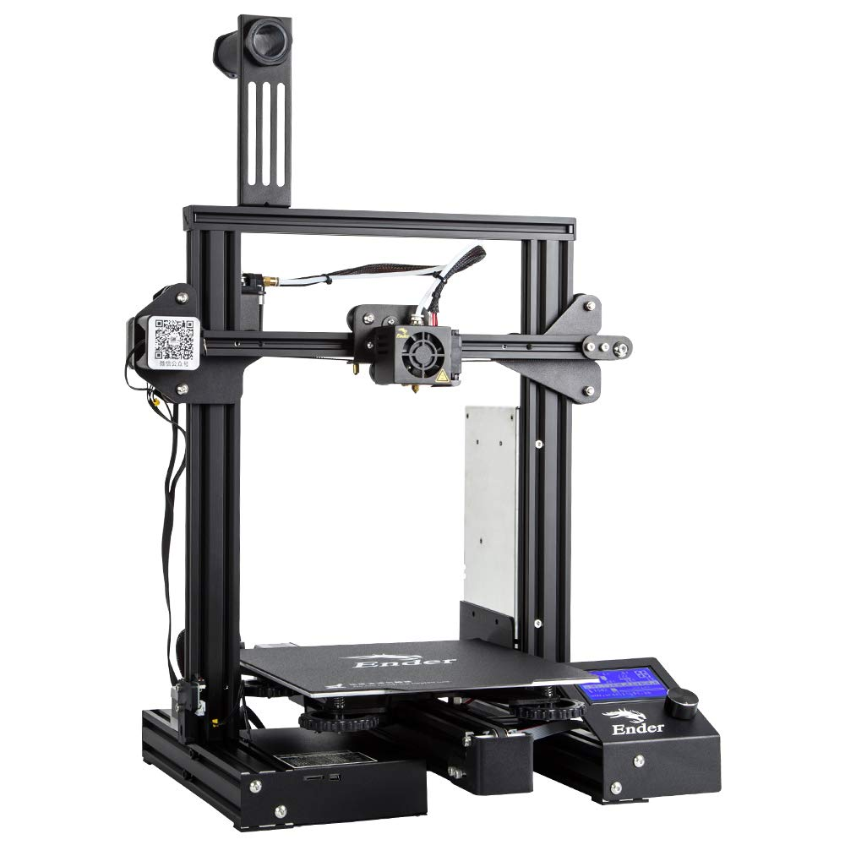
Dungeons and Dragons; An Opportunity for 3D Printing
I’m the DM, which means being prepared for different scenarios, and putting my players into a more immersive story.
So I bought a 3D Printer. Creality Ender 3 Pro, courtesy of Amazon
Operates on PLA
Considered Entry Level
Took me 4 hours to put together; and another 30 minutes to calibrate

Slide 3

From Micro SD Smuggler to the head of a Puppet Government
Started with a Micro SD card, slicing files, and physically moving them over to the printer, selecting, and hoping for a good print.
This was not (surprise surprise) effective at all.

Slide 4

Enter a Raspberry Pi, loaded with Octoprint
Loads onto a Pi
Acts as a Remote Master to the 3D Printer
Has local storage for files/organization
PRODUCES LOGS!

Slide 5
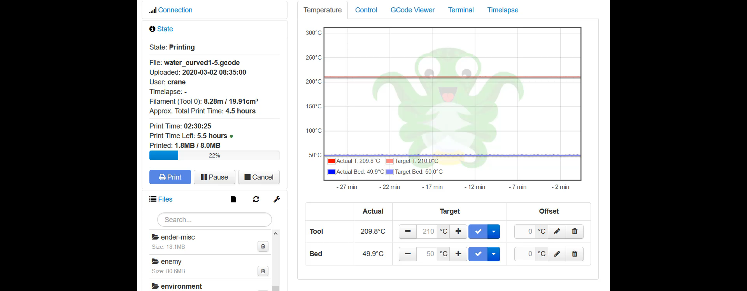

Slide 6
Load up a Splunk Forwarder, and enable logs
Requires the ARM Splunk Forwarder download
(splunkforwarder-8.0.1-6db836e2fb9e-Linux-arm.tgz)
Installs just like any other forwarder
Configure your logs in OctoPrint
Write some configurations!

Slide 7
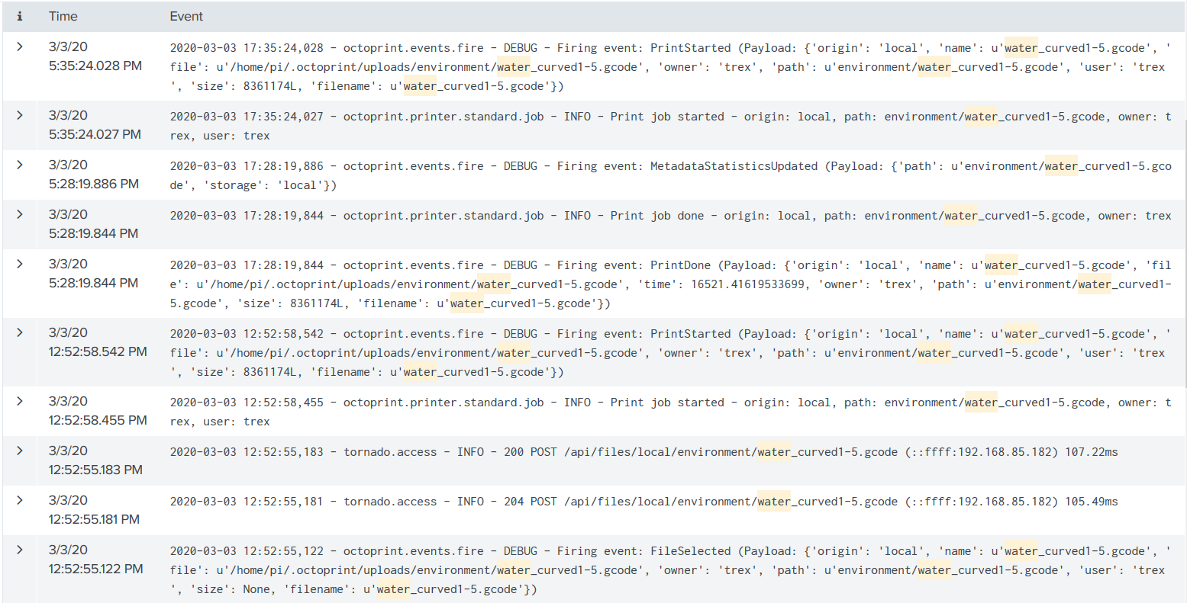
Splunk Time
OctoPrint Logs
Comes from OctoPrint on Pi
Covers everything from Heartbeats, to Statuses
Used to pull practical and measurable information
  Print Time, actual and estimated
  Customized categorization

Slide 8
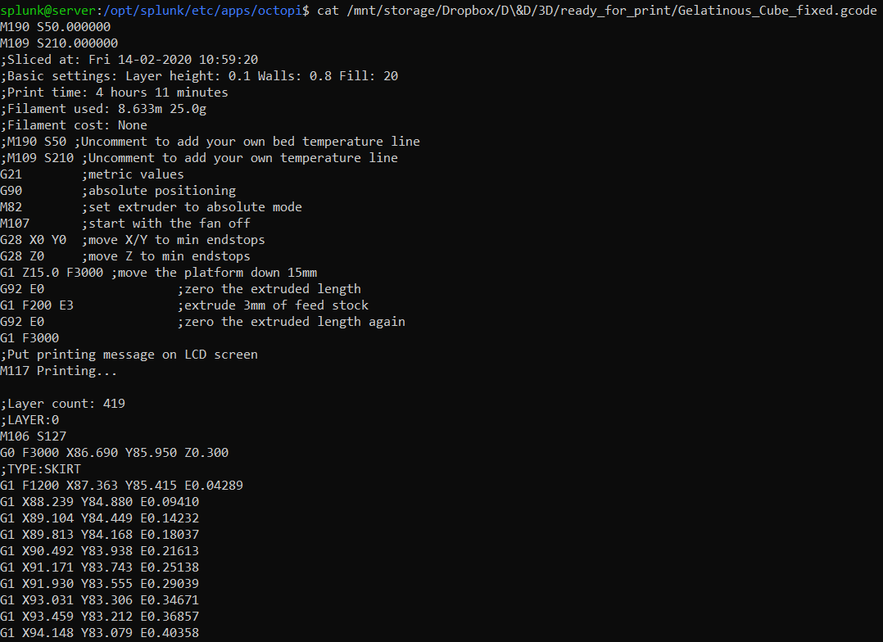
Splunk Time
Creality Sliced GCode Files (3D Printing Instructions)
Sliced on a Laptop, uploaded to a Dropbox, with Splunk monitoring the files
Provides a wealth of information
Also filled with unnecessary information (Actual Slice Instructions)
Wrote a Props to pull the first 6 lines

Slide 9
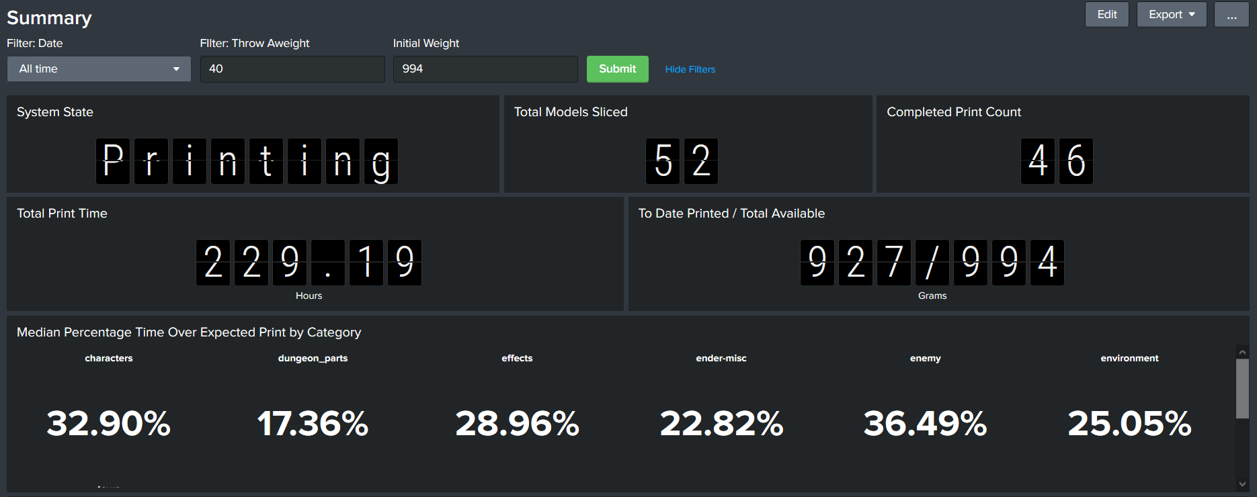
The Summary

Slide 10
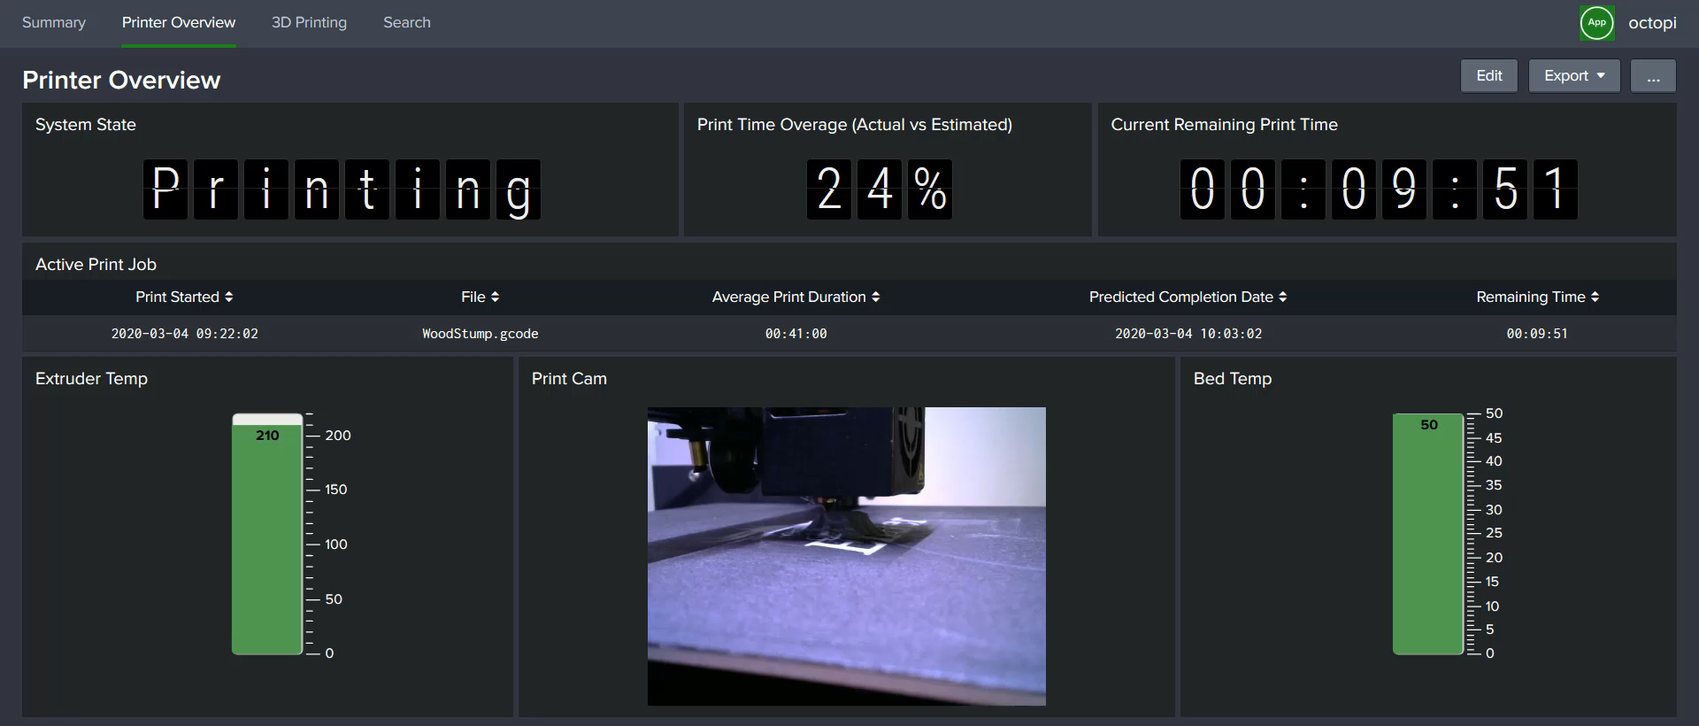
The Active Overview

